Slide 1
METHODOLOGY

Slide 2
Eye Tracking Device
Tobii Pro Nano is eye tracking device which can track their gaze in real time.
This is Video-based pupil- and corneal reflection eye tracking with dark and bright pupil illumination modes.
One camera capture images of both eyes for accurate measurement of eye gaze and eye position in 3D space, as well as pupil diameter.
The calibration of the eye tracking device was done for all he participants before the experiment.
The AOI and TOI’s were defined in each slides prior to the test and each experiment is recorded and saved the parameters in the participant name.
From tobii pro data was exported into local drive in excel format and which contains time stamp, gaze origin, Gaze point, pupil diameter and subjects repones as output.

Slide 3
Experiment
The Experiment conducted is based on the DRM paradigm, 23 participants from different background and age group were voluntarily participated for the experiment.
All off them had a normal or corrected-to-normal eyesight with no prior history of neurological or psychiatric diseases.
The participants were shown a scene related to their daily life and asked them to remember the objects that they saw in the image and then a series of slides with different object names related to the scene is presented to them.
In that some were actually presented in the scene and the others are related to the scene but not shown in the image.
In the retrival task, subjects are asked whether they remember previously presented words, as well as related (but never presented) critical lure words.

Slide 4
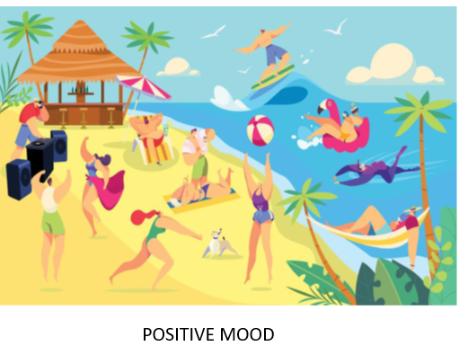
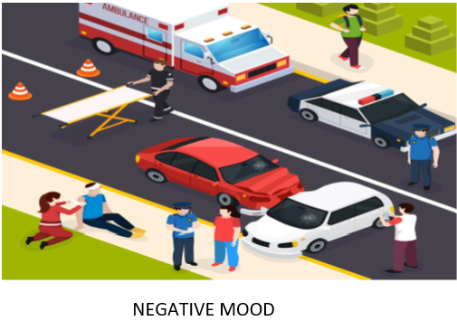
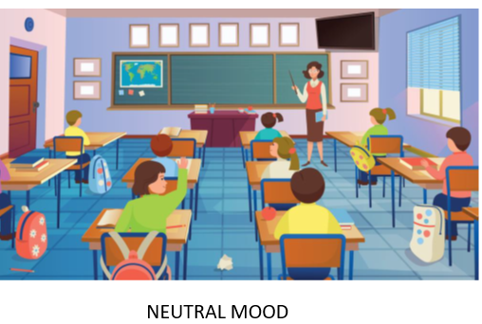
The purpose of this experiment is to identify the true memory or false memory by using three different emotions-based images. These images are chosen based on three moods of our life.

Slide 5
EXPERIMENT FLOWCHAT

Slide 6
Total showed eight objects that were related to the scenes, in that 8 objects, 4 of them were actually presented in the scene and the other 4 which were related to the scene but not shown in the image.
The objects names were written in a slide, with a boundary box and placed in the center of the screen.
Scenes were presented to the participants for 40 secs each and during the retrieval phase the objects slides is 2 secs
The subjects were then asked to give there response by pressing ‘Y’ and ‘N’ keys in the keyboard, in which ‘Y’ indicates a true response, means they have seen the object in the scene and ‘N’ indicates a negative response.

Slide 7
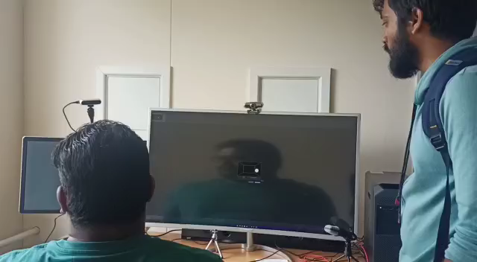
Experiment Video

Slide 8
Contribution From My side
Always volunteer the work and do it on the time which my team needed.
Collecting the information and learn the previous study of the concept of the project.
During the experiment I was with my team and help to get subjects for the same.
Throughout the project taking advices from the supervisor on each stage and did changes on the coding part accordingly.
I have done the balancing the data and took part on the model creation.
Discussed with team to fill the gaps if anything I have missed from my side on the whole process.
On the report creation I have given my part on reequipment specification and methodology part

